Slide 1
EU Hi-Drive project and cooperative trajectory planning for connected automated vehicles All Researchers' Day, Transport Area of Advance, 12 May 2023
Pavel Anistratov
Postdoc, Mechatronics, Electrical Engineering, Chalmers

Slide 2
Outline
About the Hi-Drive project
Enablers’ role in the project
Use case in the Swedish cluster
Approach to cooperative trajectory planning
Trajectory planning for trucks; driver’s models
Simulation environment
Integration work with VTEC
Future work

Slide 3




Our history of automated driving: carrying the legacy forward
Complexity
Time

Slide 4



© Volkswagen
Push towards
higher automation
Robust and reliable automated driving
Extended and defragmented ODDs
Interoperability across countries and brands

Slide 5
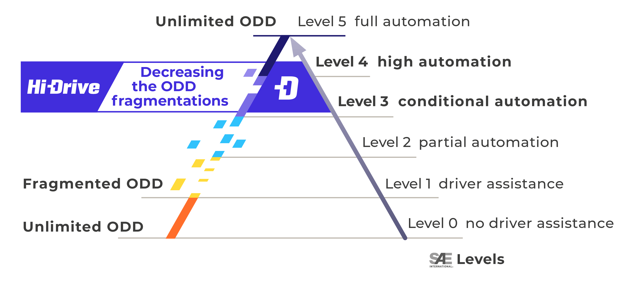
Operational Design Domain – ODD
ODD - “Operating conditions under which a given driving automation system […] is specifically designed to function […] to environmental, geographical, and time-of-day restrictions, and/or the requisite presence or absence of certain traffic or roadway characteristics.” *
*SAE J3016 (2021)

Slide 6
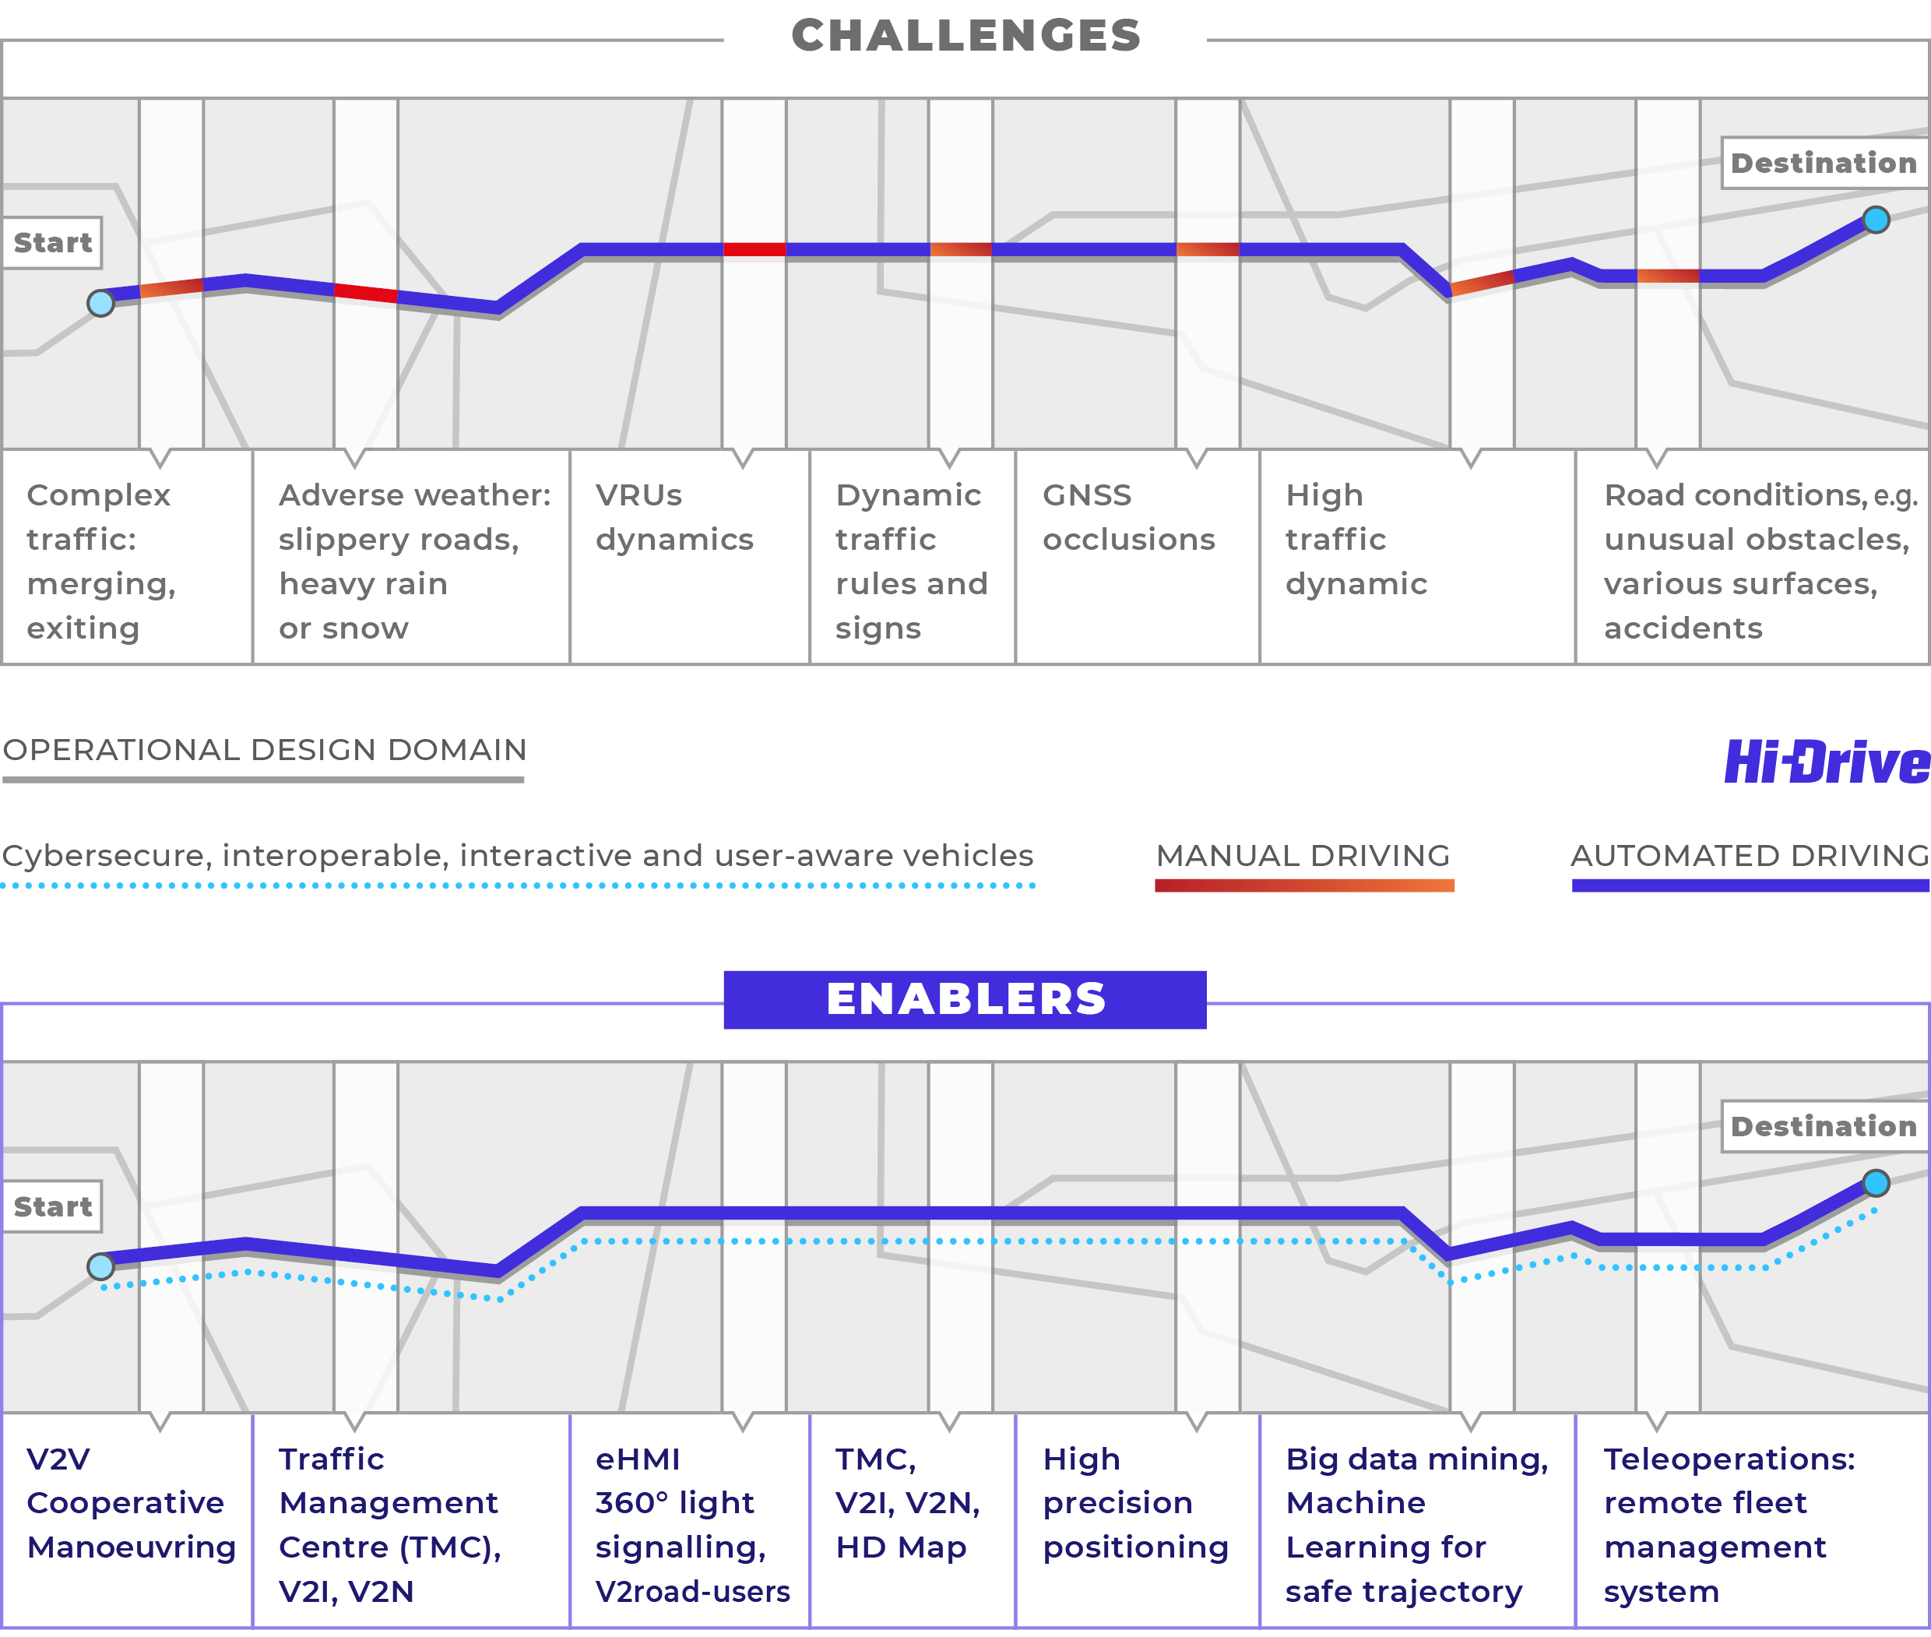
Defragmentation of Operational Design Domain
Enabling via
Resilience to cyber threats
Interoperability: vehicles of different brands, including trucks, communicating V2V; cooperative sensing and manoeuvring
Interactive vehicles: AVs communicating and interacting with vulnerable road users (V2P, VRU).
AV’s HMI: Monitoring supports driver’s / operator’s situational awareness.
TMC = Traffic Management Center
Extended field of view: AV receiving information (V2I, HD maps) to adapt to traffic beyond the line of sight.
Precise localization: vehicle positioning system to eliminate GNSS blackspots.
Use of disruptive technologies such as Big Data, IoT, Machine Learning (ML) and Teleoperation systems for seamless functioning in demanding travel conditions: complex traffic scenarios and weather conditions.

Slide 7
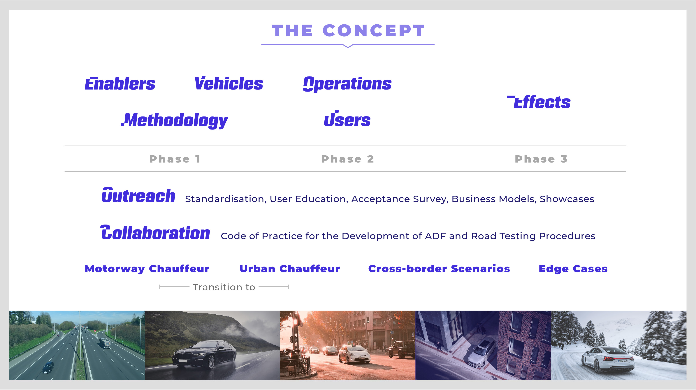

Slide 8






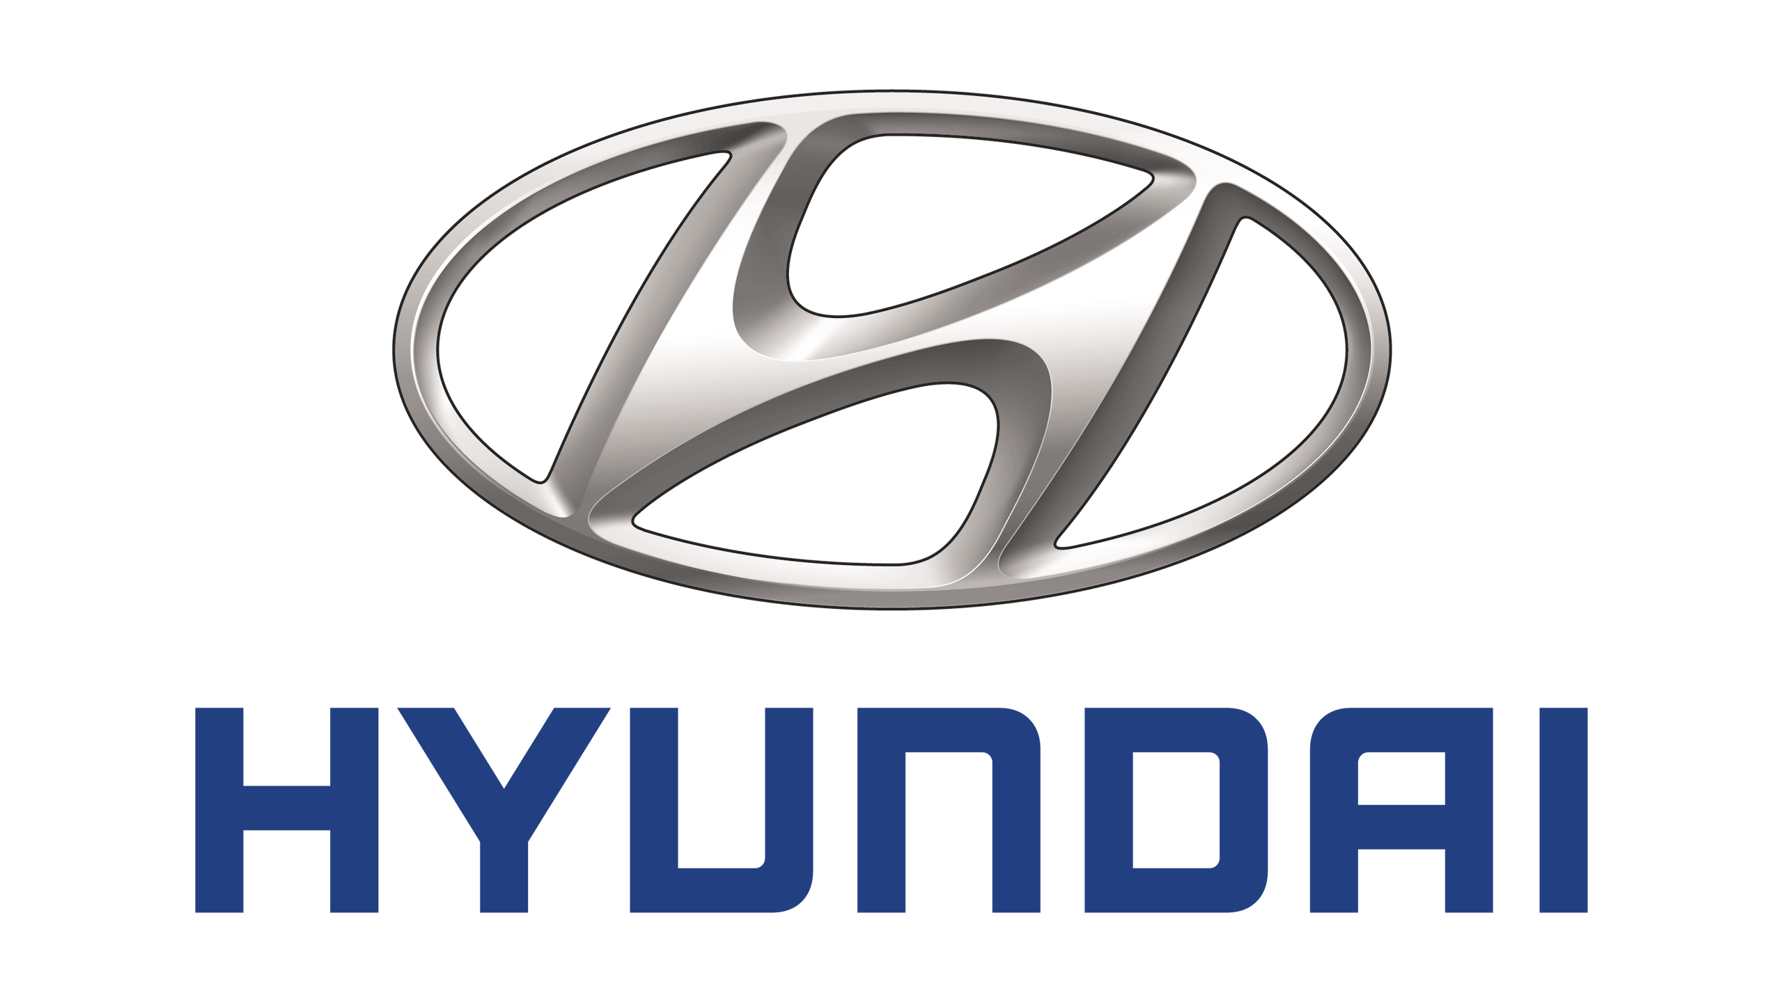










































Partners

Slide 9
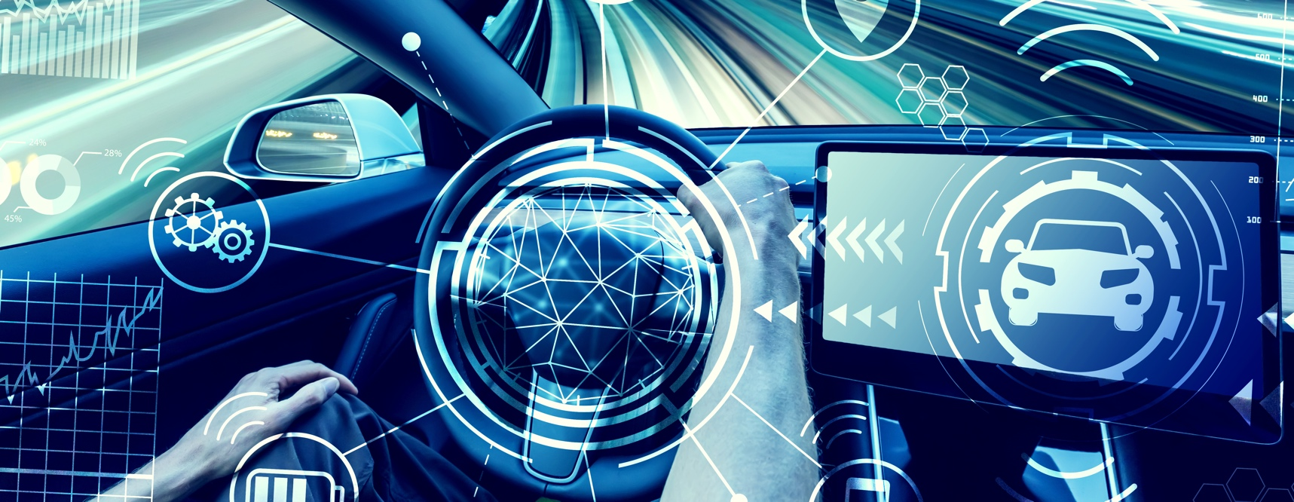

© Adobe
Technology enablers for
CAD vehicles to operate in defragmented ODDs
(Connected and Automated Driving)
Extend and Defragment ODDs
Enablers Cards and KPIs
Connectivity & Digital Infrastructure
High Precision Positioning
Resilience to Cyber threats
Machine Learning for ADs

Slide 10
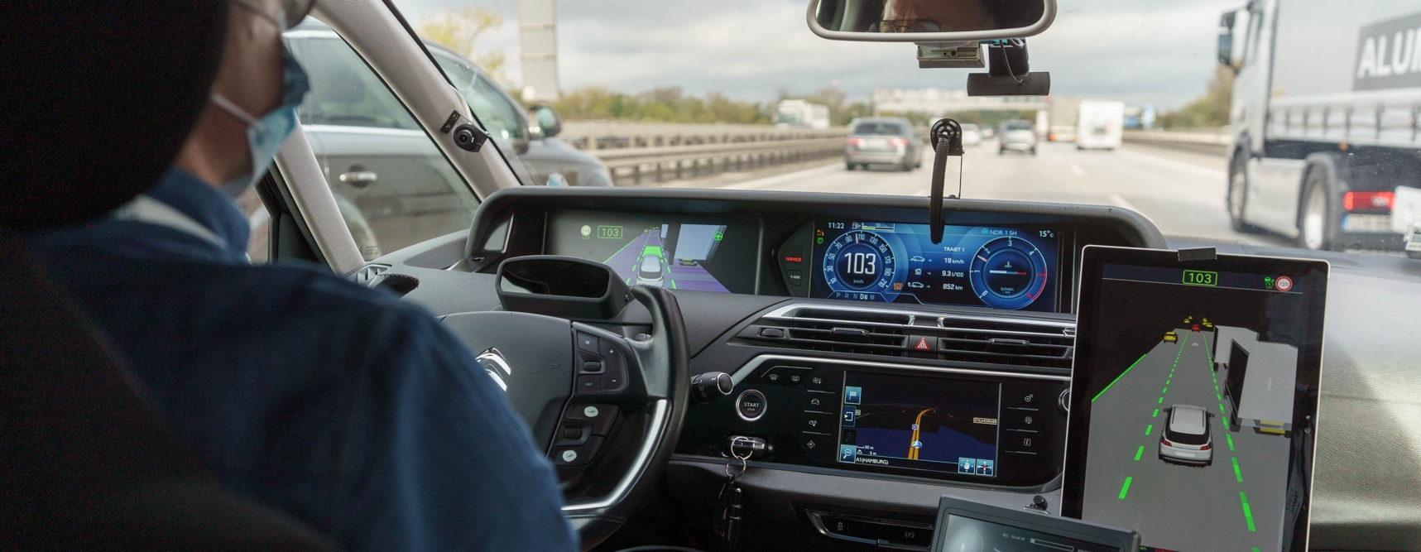

© EICT
Define and build up high automation fleet - passenger cars and trucks.
Use Cases & Scenarios
Logging Tools
CADFs with Enablers
Setting up the Testing & Demo System
Vehicles Preparation & Pre-testing

Slide 11
Objectives
Assess the current technological capabilities of the vehicles and integrate CAD enablers to answer the research questions.
Define a set of use cases based on the identified vehicles functions and capabilities, including the description of the AD function, the enablers and their ODDs.
Carry out pre-tests to ensure the end-to-end process works in preparation for the main test operations in SP Operations.

Slide 12
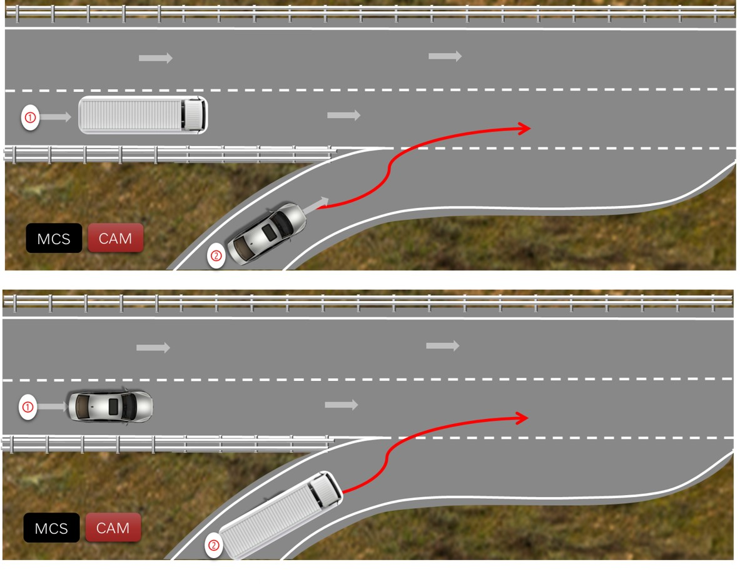
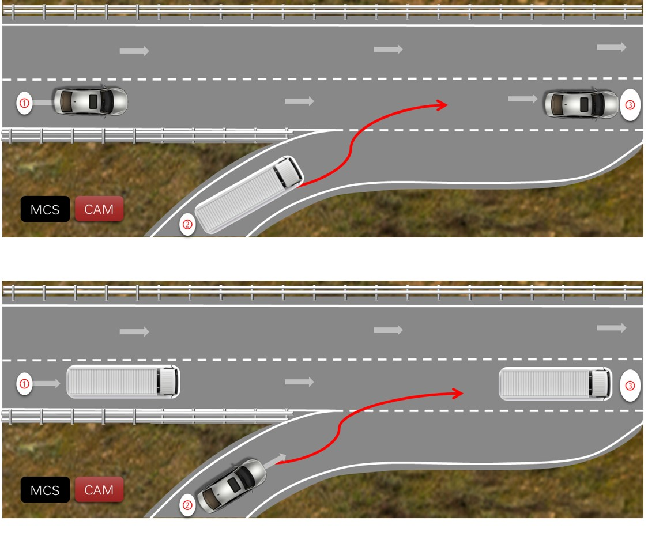
Use Case – Lane Merge

Slide 13

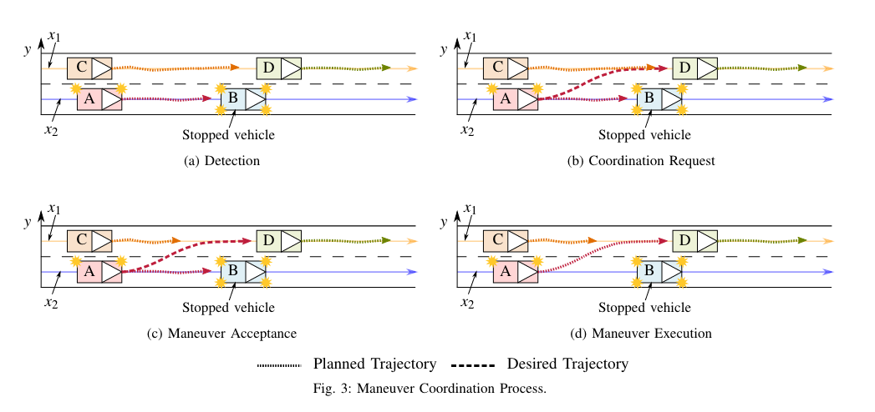
Approach to Coordination
By sharing a vehicle’s planned maneuver with surrounding traffic participants, inter-vehicle communications reduce the uncertainty associated with the prediction of future vehicle maneuvers. In case of conflicting maneuvers, vehicles are given the opportunity to disseminate a desired trajectory in addition to its planned trajectory. Maneuver coordination is then established in a three-step implicit distributed fashion, based on common right-of-way rules and on both disseminated types of trajectories.

Slide 14
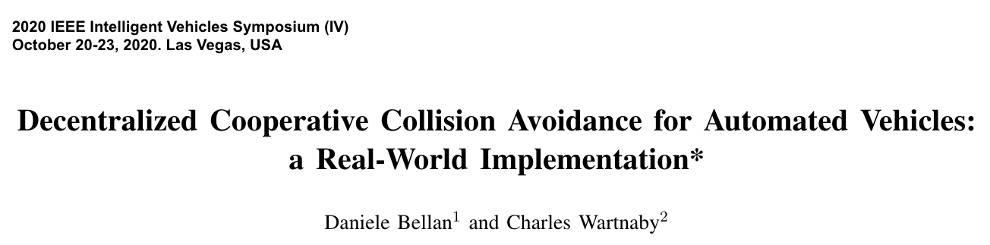
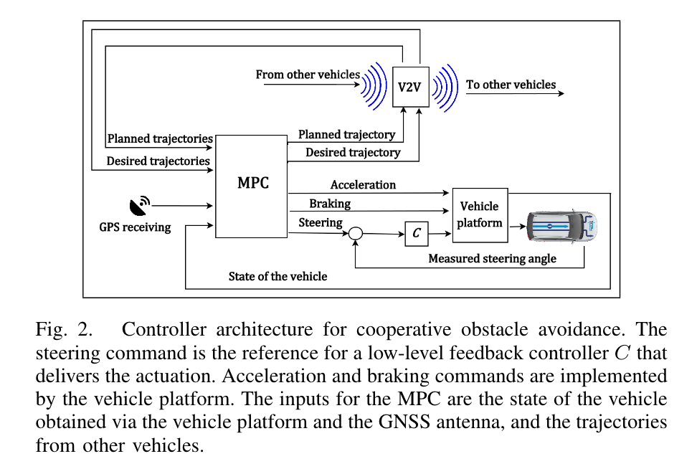
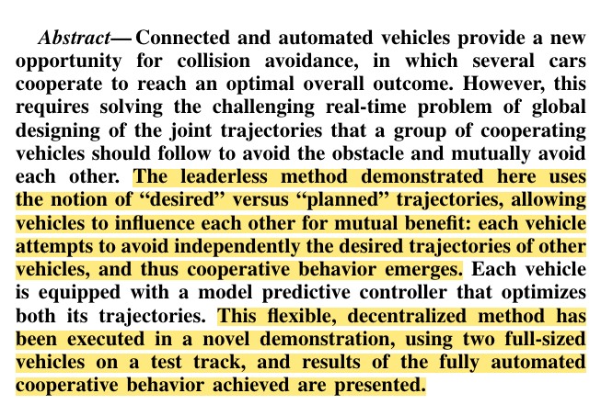
MuCCA Experimental Validation

Slide 15
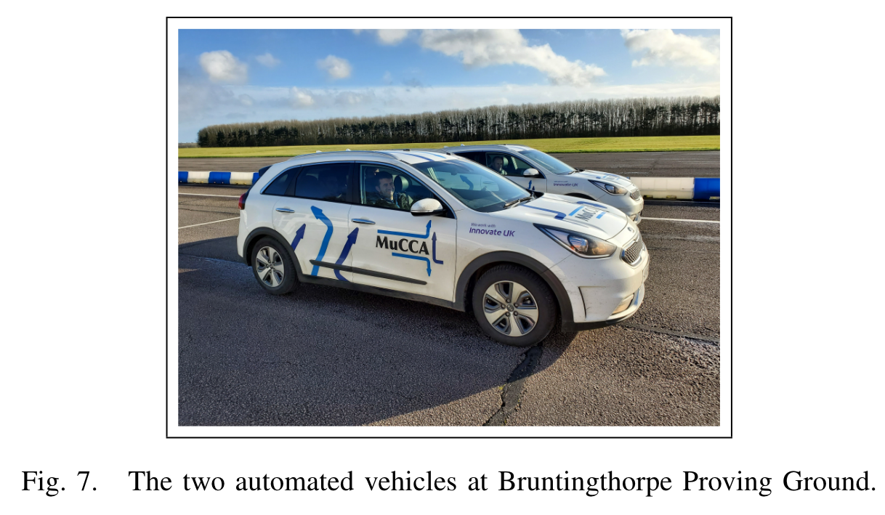
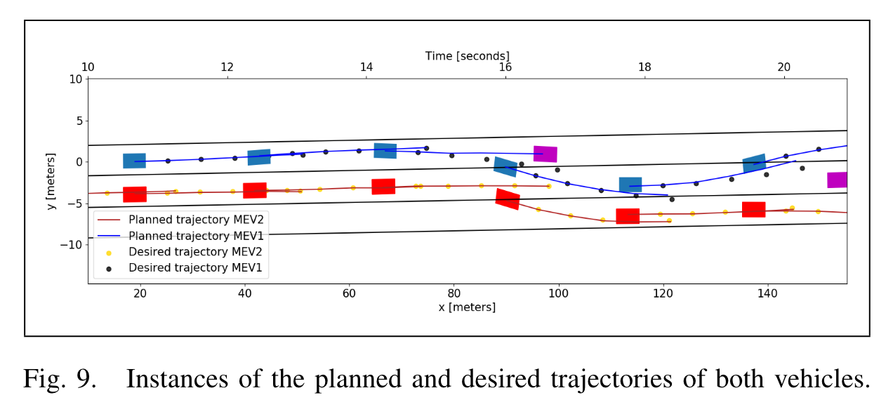
MuCCA Experimental Validation

Slide 16
What is Different in Uur Case
Two different companies: Volvo Cars (VCC) and Volvo Technology (VTEC)
Two different types of vehicles: car and truck
Different automation levels: L3 and L1
Compatible but different approaches to trajectory planning
Trajectory prediction and planning for a human-driven vehicle on long distances
Maneuver coordination message (MCM) format
Independent implementations
Truck is CV – a collaborative vehicle
Car is CAV – a collaborative autonomous vehicle

Slide 17
Trajectory Prediction and Planning in Truck
Inputs
Date filter
Trajectory prediction
Predicted trajectory own
Planned trajectory others
Interacting vehicles
Trajectory planning
Driver
Planned trajectory own:
Speed/acc (long.)
Lane-change or not (lat.) when in merging position
V2V Message
HMI/ ADS
Loop at certain frequency

Slide 18



Plan (prediction)
Plan
$$T_{0}$$

Slide 19

Plan (future speed reduction)
Plan + Desire
Truck starts computing new planned trajectory with planned speed reduction
$$T_{0}$$
$$T_{1}$$
Conflict detected
Car switches to new (non-conflict) planned trajectory and sends desired trajectory

Slide 20
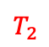
Plan (future speed reduction)
Plan + Desire
Truck stops computing new planned trajectory Speed advice sent to driver Truck speed reduced
Truck starts computing new planned trajectory with planned speed reduction
$$T_{0}$$
$$T_{1}$$
$$T_{2}$$
Conflict detected
Car switches to new (non-conflict) planned trajectory and sends desired trajectory

Slide 21
Plan (future speed reduction)
Plan + Desire
Truck stops computing speed reduction Speed advice sent to driver Truck speed reduced
Truck starts computing new planned trajectory with planned speed reduction
$$T_{0}$$
$$T_{1}$$
$$T_{2}$$
Conflict detected
Car switches to new (non-conflict) planned trajectory and sends desired trajectory
Negotiation period

Slide 22
Plan (prediction)
Plan + Desire
Truck stops computing new planned trajectory Speed advice sent to driver Truck speed reduced
Truck starts computing new planned trajectory with planned speed reduction
$$T_{0}$$
$$T_{1}$$
$$T_{2}$$
Conflict detected
Car switches to new (non-conflict) planned trajectory and sends desired trajectory
Negotiation period

Slide 23
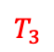
Plan (prediction)
Plan
Truck stops computing new planned trajectory Speed advice sent to driver Truck speed reduced
Truck starts computing new planned trajectory with planned speed reduction
$$T_{0}$$
$$T_{1}$$
$$T_{2}$$
$$T_{3}$$
Conflict detected
Car stops sending desired trajectory
Car switches to new (non-conflict) planned trajectory and sends desired trajectory
Negotiation period

Slide 24
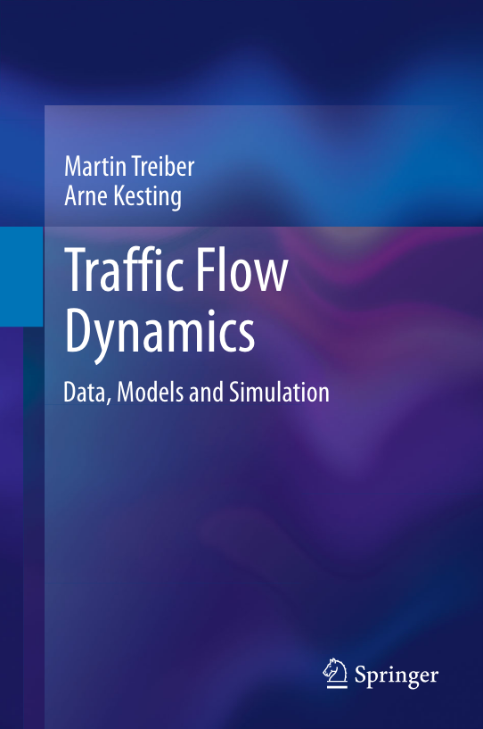
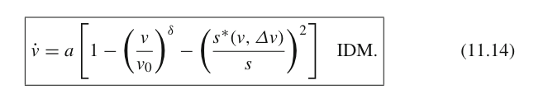
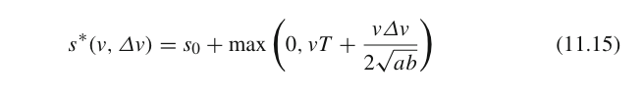
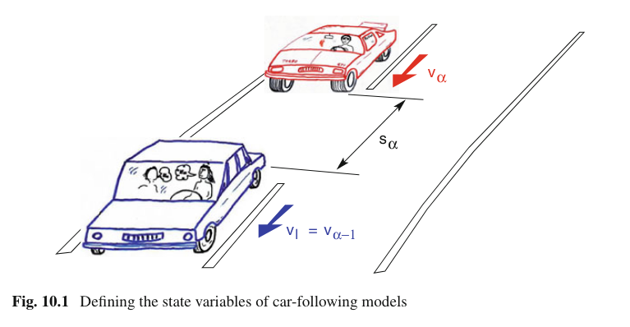
Driver Models
Intelligent Driver Model (IDM)
Improved Intelligent Driver Model (IIDM)

Slide 25
Simulation Enviroment
CAV – car (blue)
Cooperative but not helping vehicle driving a constant speed
CAV – car (green and orange)
Trajectory planning via solving an optimization problem (CasADi and IPOPT) for a particle model
Objective function for reduced actuation (longitudinal land lateral acceleration), avoid collisions
LQR to follow the trajectory
CV – truck (blue and orange)
Trajectory prediction via IIDM, conflict resolution by testing different velocity reductions
Objective is to reduce the variation of longitudinal acceleration and avoid conflicts
Code reuse: implementation for CV is possible to separate from the environment

Slide 26
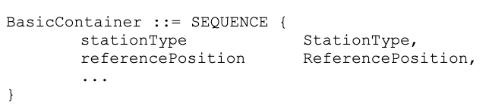
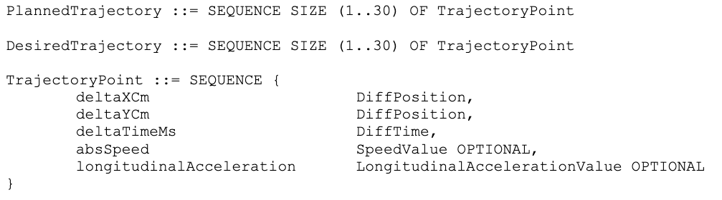
Maneuverer Coordination Message (MCM)
Adapted message format from TransAID (Transition Areas for Infrastructure-Assisted Driving): MCM ASN.1 specification
Abstract Syntax Notation One (ASN.1) is a standard interface description language for defining data structures that can be serialized and deserialized in a cross-platform way
With a reference to ETSI TS 103 561 V0.0.2 (2022-09): Intelligent Transport Systems (ITS); Vehicular Communications; Basic Set of Applications; Manoeuvres’ Coordination Service; Release 2.

Slide 27
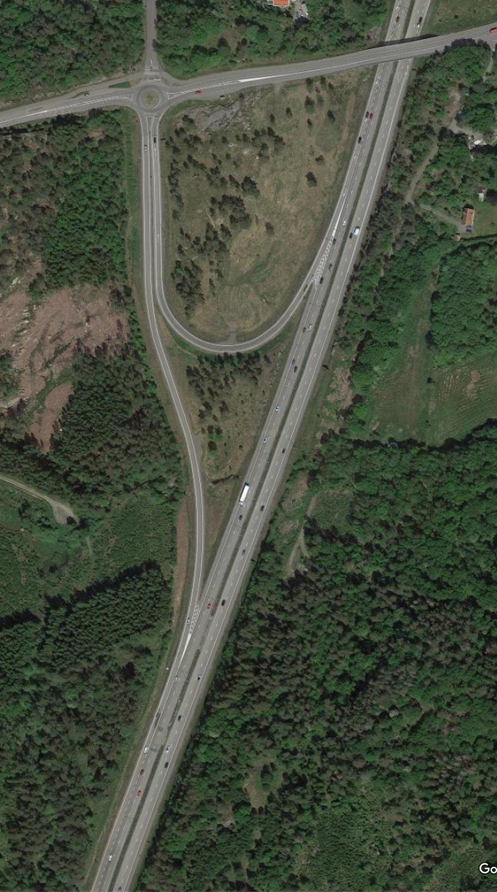
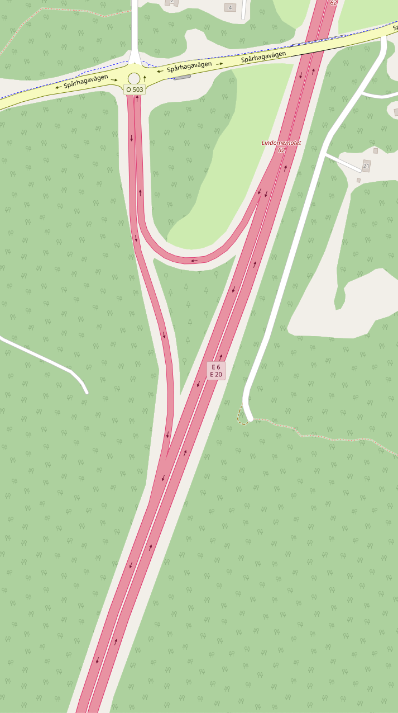
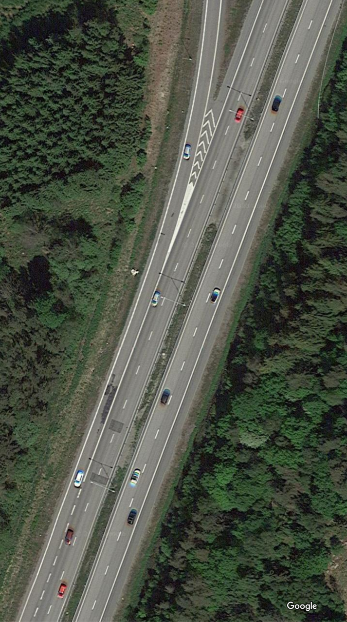
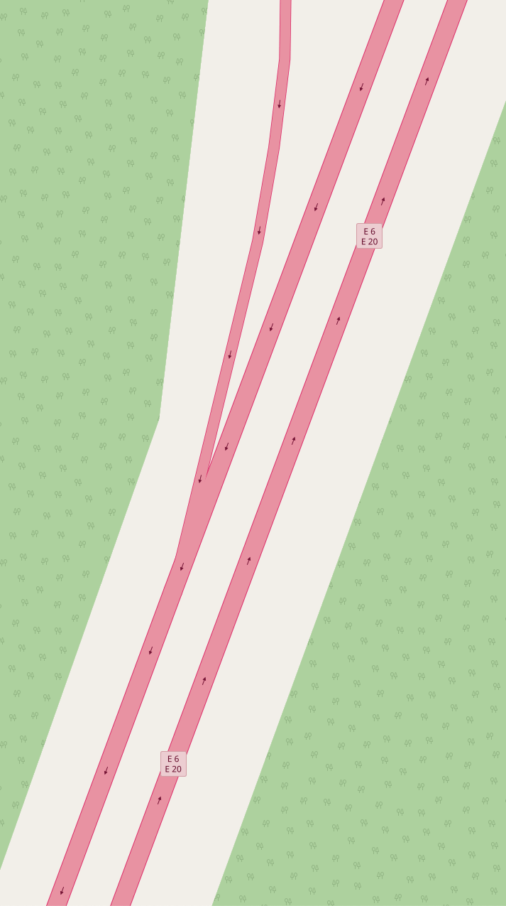
Example Image of a Highway Merging

Slide 28
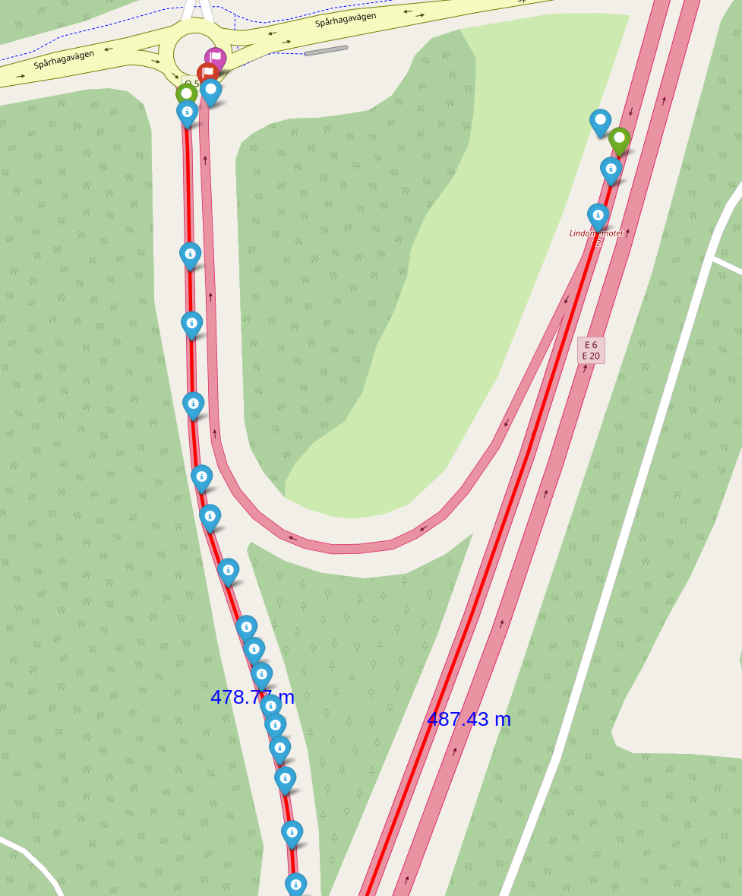
Coordinate Transformations

